Slide 1

Learning Spark Sql
Dingtinghe
dingth@chinatelecom.cn

Slide 2
Overview
Spark SQL is a Spark module for structured data processing.
It provides a programming abstraction called DataFrames and can also act as distributed SQL query engine
Creating and Running Spark Programs Faster: - Write less code - Read less data - Let the optimizer do the hard work

Slide 3
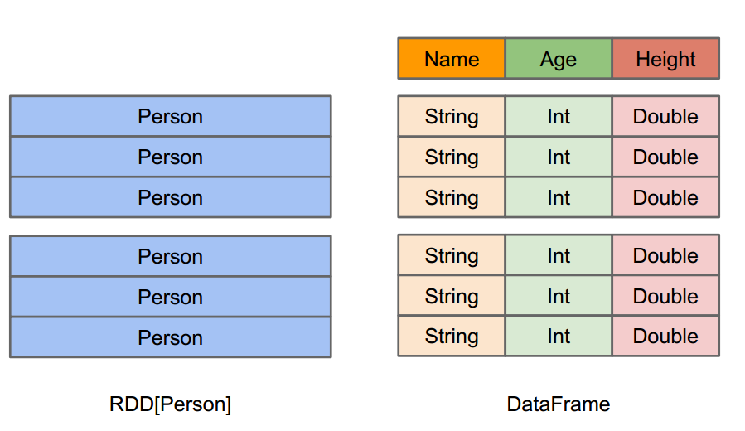
DataFrame
A distributed collection of data organized into named columns, as a table
An abstraction for selecting, filtering, aggregating, and plotting structured data
Single machine small data processing experiences applied to distributed big data

Slide 4
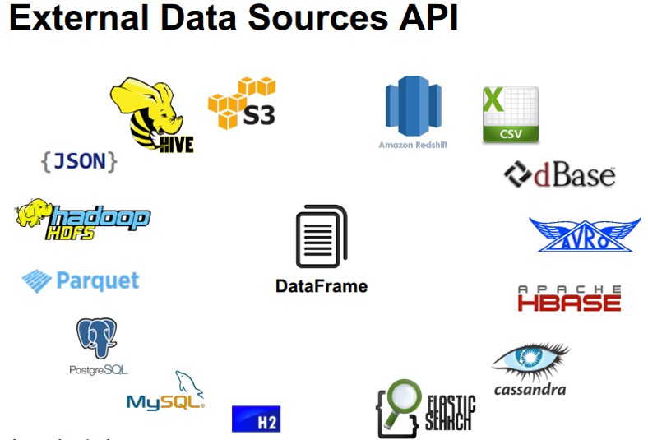
DataFrame Source
structured data files
tables in Hive
existing RDDs
external databases

Slide 5
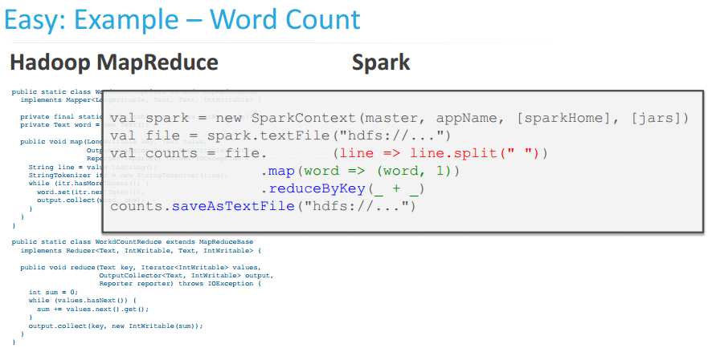
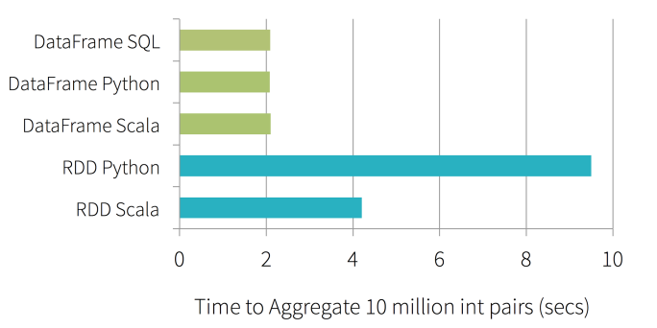
Performance
Less Code!
Run Faster!

Slide 6
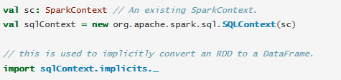
Starting Point: SQLContext
The entry point into all functionality in Spark SQL is the SQLContext class, or one of its
descendants.
To create a basic SQLContext, all you need is a SparkContext.
Future releases will focus on bringing SQLContext up to feature parity with a HiveContext.

Slide 7
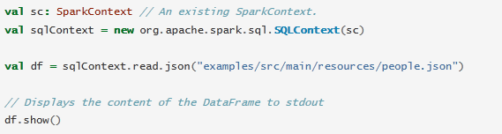
Creating DataFrames
DataFrames from an existing RDD, from a Hive table, or from data sources.

Slide 8
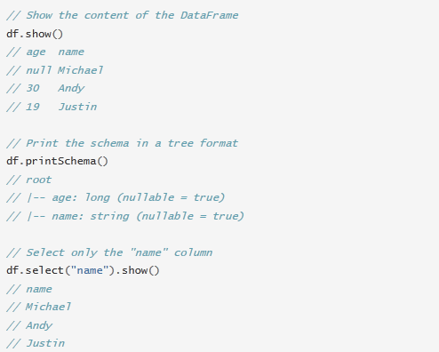
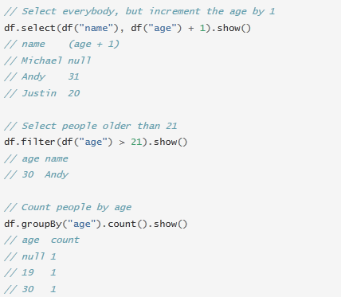
DataFrame Operations (some basic examples )
Dataframes also have a rich library of functions including string manipulation, date arithmetic, common math operations and more.

Slide 9
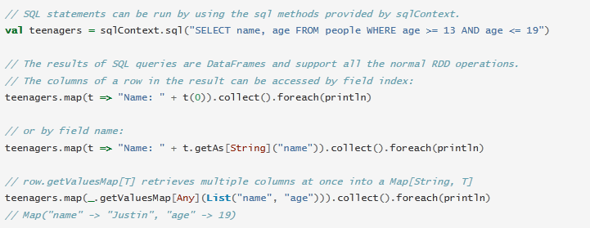
Running SQL Queries Programmatically

Slide 10
Interoperating with RDDs
Inferring the Schema Using Reflection
More concise code and works well
When you already know the schema while writing your Spark application.
Programmatically Specifying the Schema
More verbose
when the columns and their types are not known until runtime.

Slide 11
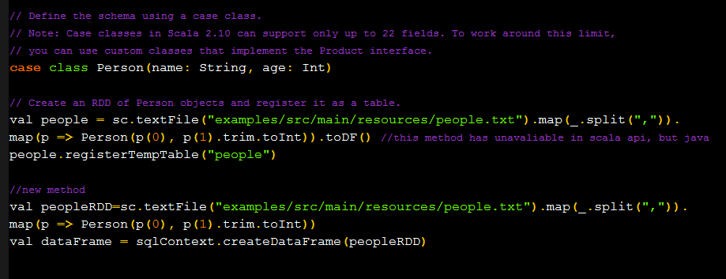
Inferring the Schema Using Reflection

Slide 12
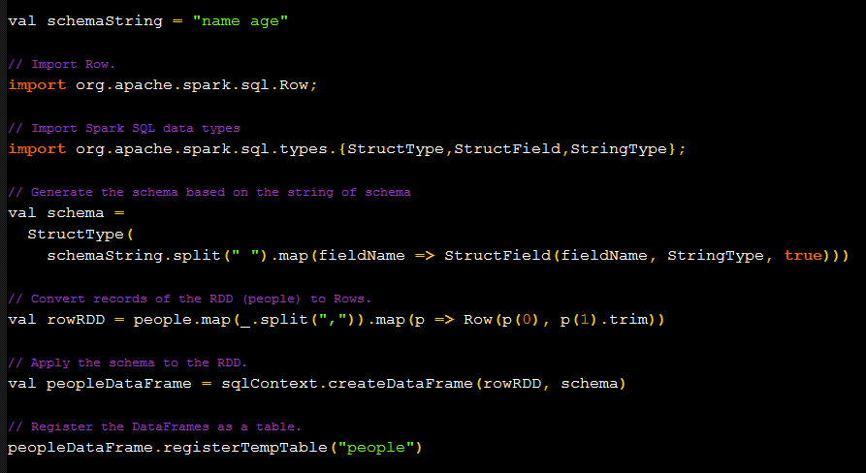
Programmatically Specifying the Schema

Slide 13
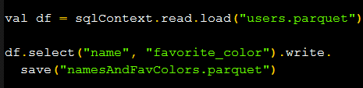
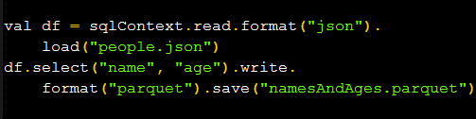
Data Sources
Generic load/save functions
Manually specifying options

Slide 14
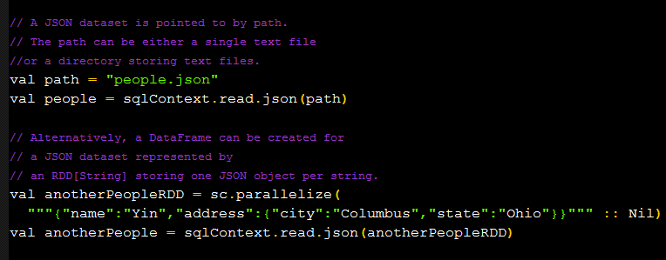
JSON Datasets
Using SQLContext.read.json() on either an RDD of String, or a JSON file.

Slide 15
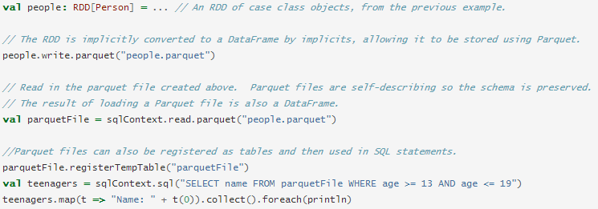
Parquet Files
Can make the advantages of compressed, efficient columnar data representation available to any project in the hadoop ecosystem
Support partition discovery, schema merging, metadata refreshing

Slide 16
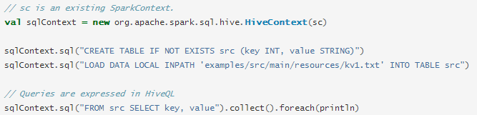
Hive Tables
Must construct a hivecontext, which inherits from sqlcontext
Writing queries using hiveql.
Can interacting with different versions of hive metastore

Slide 17
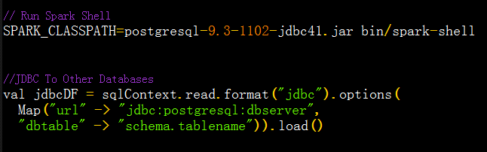
JDBC To Other Databases
Spark SQL JDBC server is different with SQL JDBC server
Should include the JDBC driver for you particular database on spark classpath

Slide 18
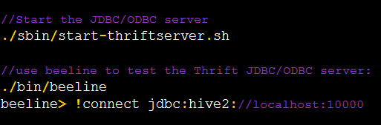
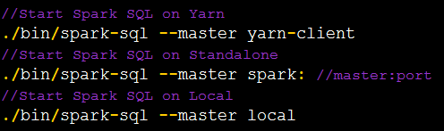
Distributed SQL Engine
Running Hive thrift JDBC/ODBC server
Running the spark SQL CLI

Slide 19
Performance Tuning
Caching Data In Memory Then compression to minimize memory usage and GC pressure
spark.sql.inMemoryColumnarStorage.compressed
spark.sql.inMemoryColumnarStorage.batchSize
Query Execution Configuration
spark.sql.autoBroadcastJoinThreshold
spark.sql.tungsten.enabled
spark.sql.shuffle.partitions
spark.sql.planner.externalSort

